Slide 1


Depression Awareness
ONE -DAY LESSON

Slide 2

Establish Group Norms
We want to make sure we conduct this lesson in a safe and caring classroom.
We will respect each other.
We will do our best to answer all questions. However, some questions may need to be addressed with a trusted adult in a confidential location.
3. Everyone will be able to safely share private information and feelings with a trusted adult.

Slide 3
Erika's Lighthouse Overview
This program was inspired by a young person named Erika. Erika was a bright light who, sadly, lost her battle with depression in 2004, at age 14.
Erika's Lighthouse was founded in her honor and is dedicated to helping other young people learn about depression and overcome the stigma surrounding mental health disorders.

Slide 4


You will learn...
Depression is a mood disorder
Signs & symptoms of depression
How to identify a reliable, trusted adult at school and/or in the community
How to maintain good mental health

Slide 5
We’d Like to See What you Already Know
Type the URL address to take a short pre-test.
http://elhms.info

Slide 6
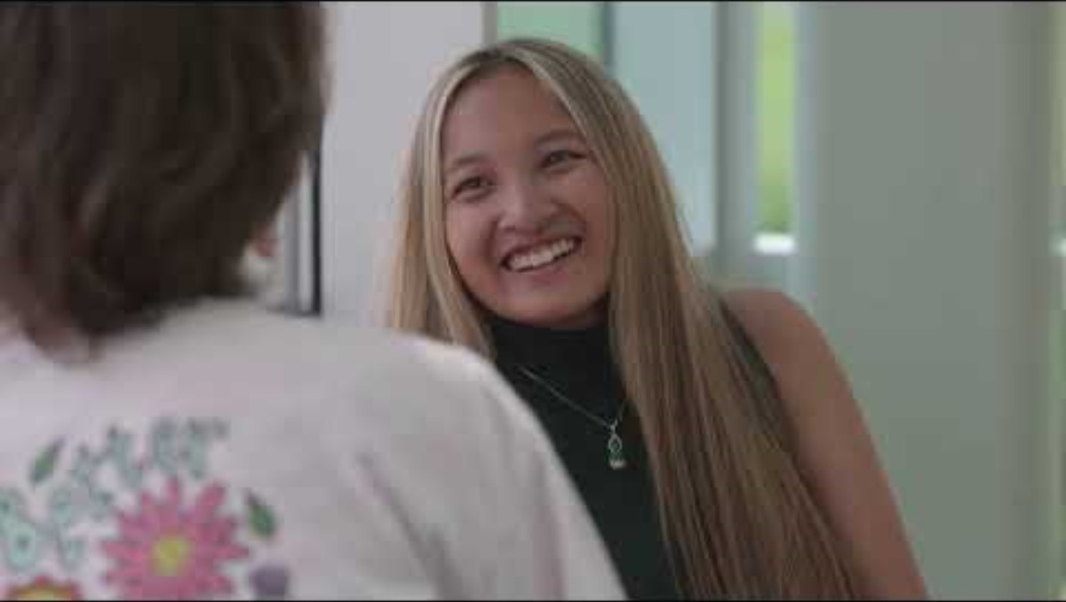
The Video

Slide 7


Discussion Questions
Can you tell by someone's appearance that they have depression?
If there is a history of depression in your family it does not mean you will develop it .
How common is depression in teens?
Does this mean that anyone who experiences stress will be diagnosed with depression?
What are the signs and symptoms of depression?

Slide 8


Depression Symptoms
Depressed mood, sadness, or irritability
Loss of interest or pleasure in activities
Change in weight or appetite
Change in sleep
Feeling sped up or slowed down
Fatigue or loss of energy
Feelings of worthlessness or guilt
Trouble concentrating or making decisions
Thoughts of death or acts of self-harm
5 or more of these symptoms must be present every day for at least 2 weeks or more

Slide 9


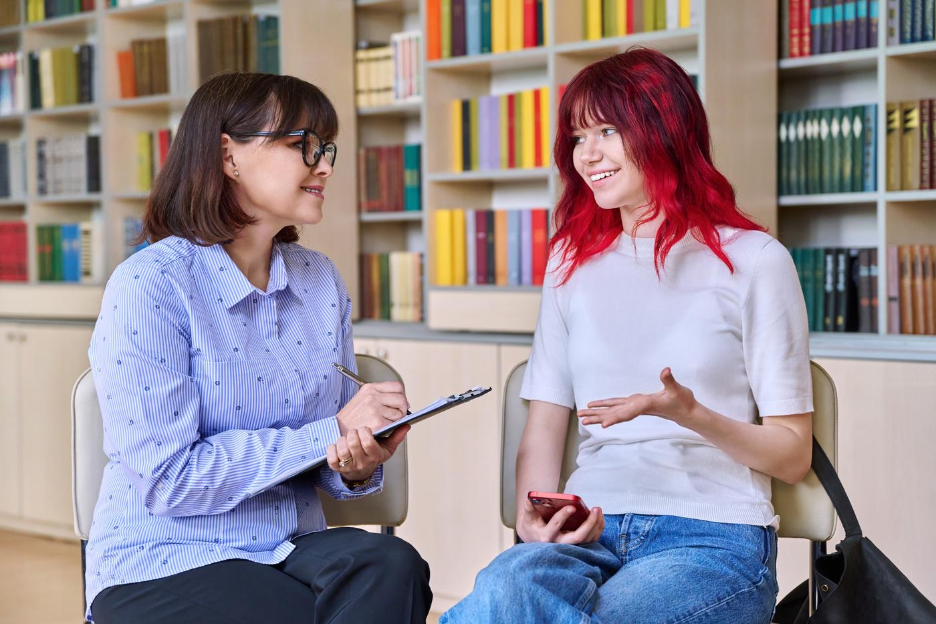
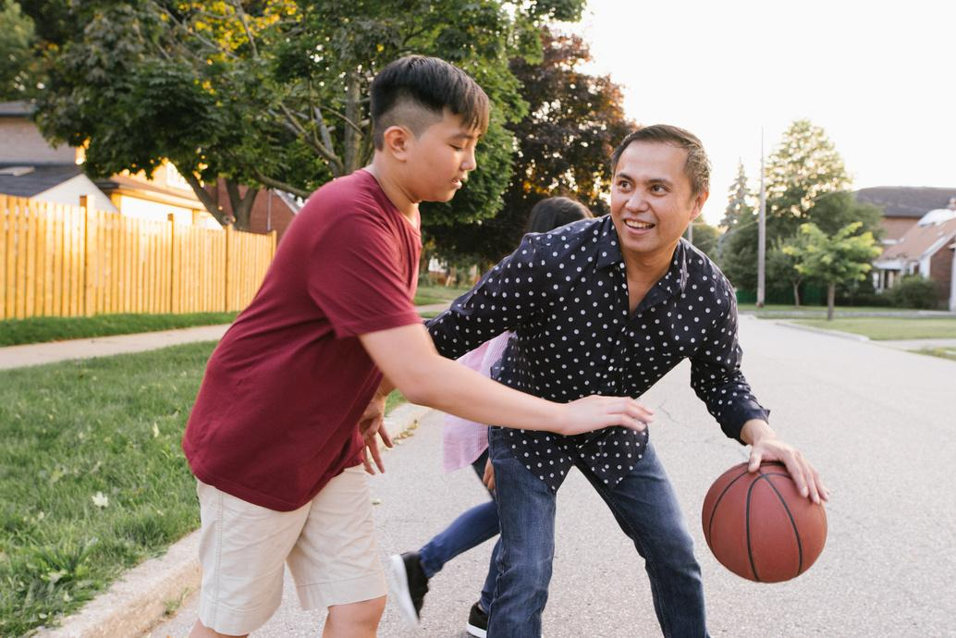
If you are worried about yourself or a friend, talk to a
Trusted Adult
When I say the words Trusted Adult, what characteristics or traits come to mind?

Slide 10

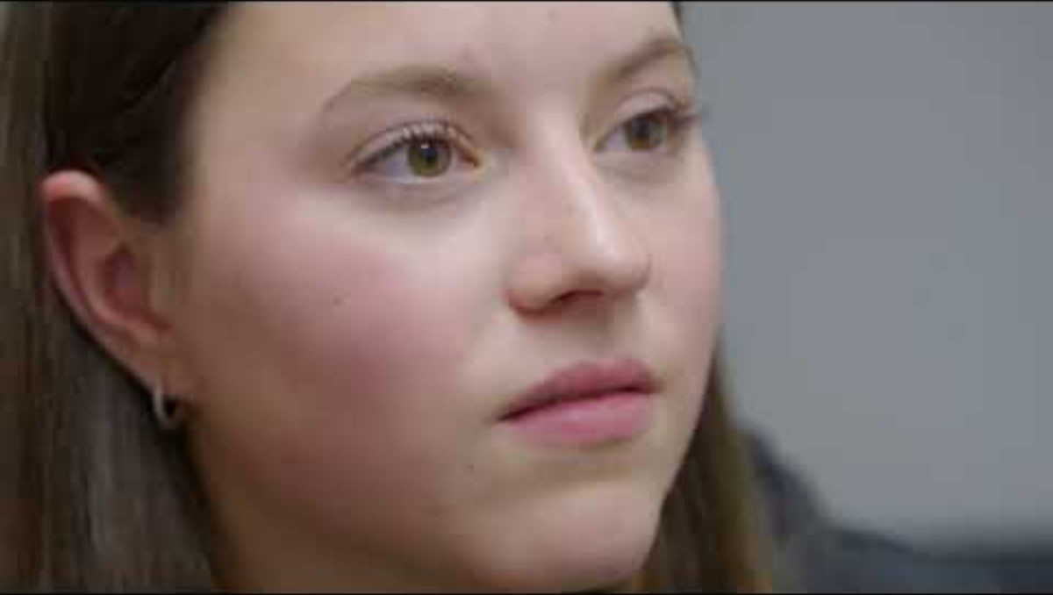
Catharine
Notes:
https://youtu.be/OUdH0VjjTGo

Slide 11

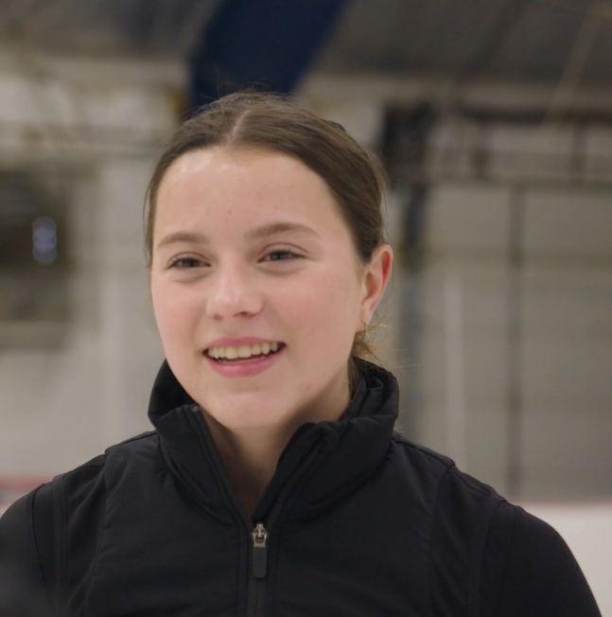

Catharine - Discussion Questions
Who are Catharine’s trusted adults?
How did they help her?

Slide 12


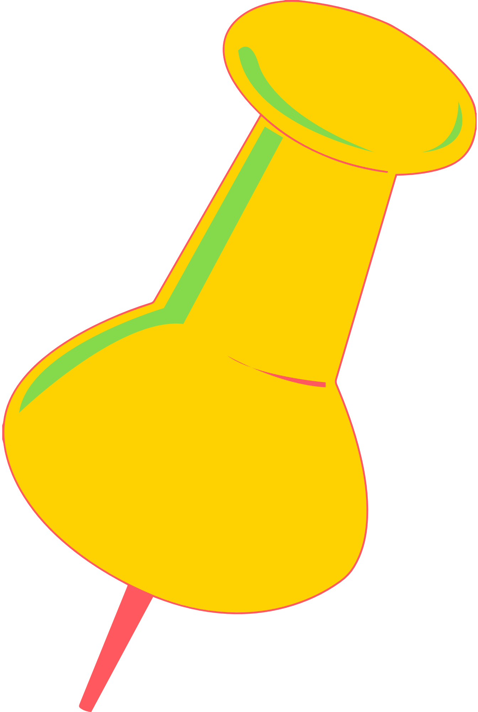
You can get help for yourself or a friend by saying something!
How to talk to a trusted adult
How to talk to a friend in need

Slide 13

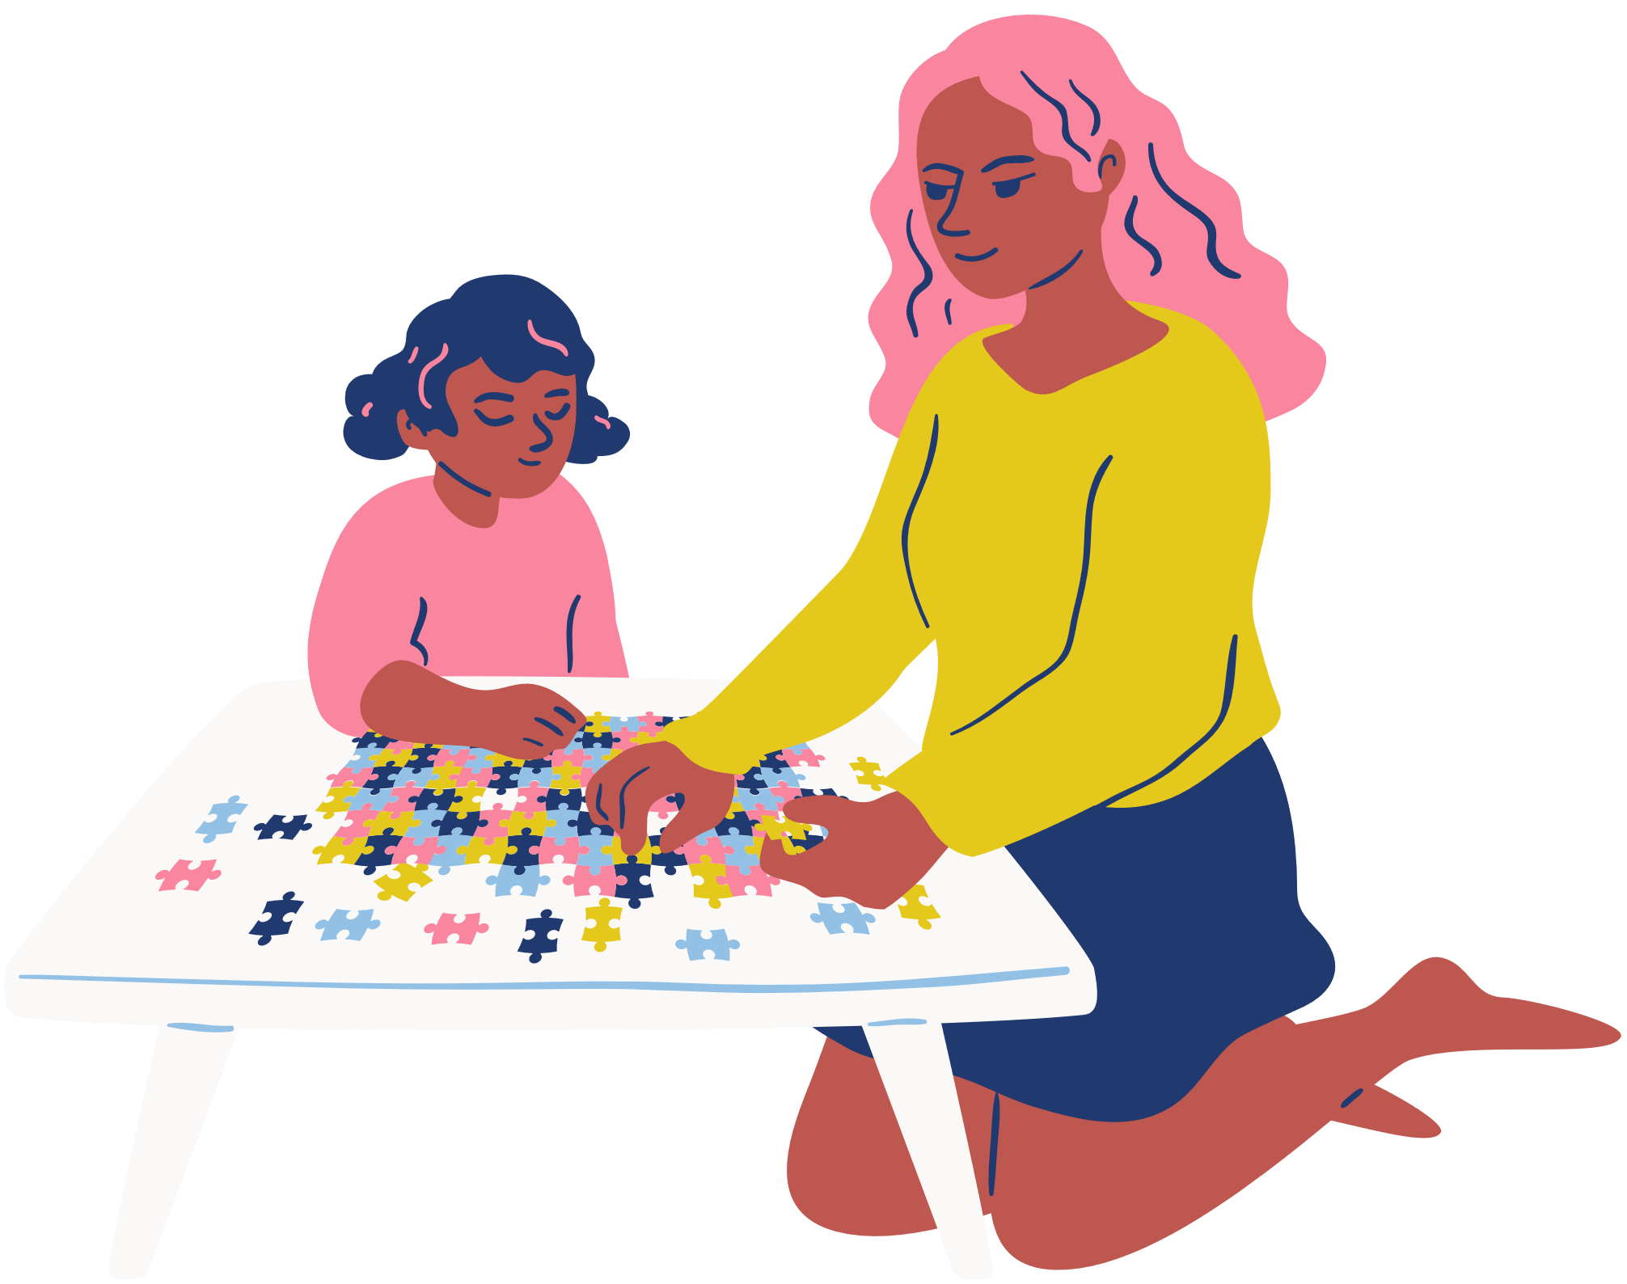


Hey Mom,
Can we talk?

Slide 14

YOU:
Hey, Mom, can we talk?
MOM:
Sure. What's going on?
YOU:
Lately, I haven't been feeling like myself. I feel sad and angry all the time. I'm constantly tired, and I can't focus in school.
MOM:
I've gone through periods like this when I was your age. Hang in there and I'm sure things will get better with a little time.
YOU:
Well, usually when I'm down I feel better if I go for a run or talk to someone. This time I can't seem to shake it. It's been like this for a few weeks now. I think I need to talk to someone. Can you help me set up an appointment with my doctor?
MOM: Sure. I think that’s a great idea.

Slide 15
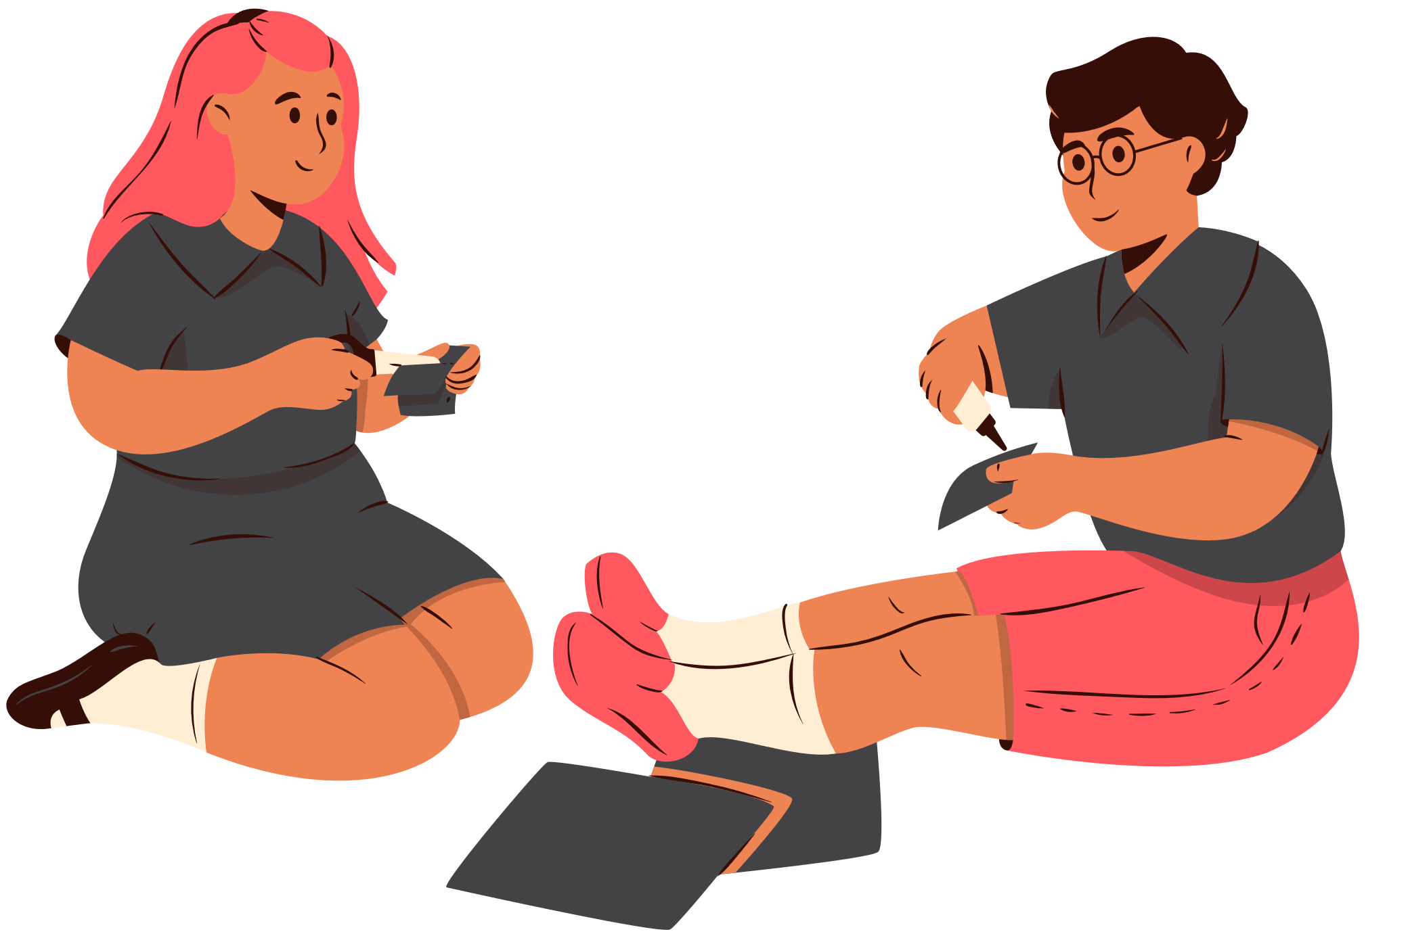

Hey Sam,
Can we talk?

Slide 16
SAM: Hey, can we talk? Over the past few weeks, I’ve noticed you've been hanging back a lot – not calling or texting me much anymore and skipping out on me and our friends. Recently, you have even missed quite a few play practices. In general, you seem down. This isn’t like you. What’s going on?
FRIEND: I’m sorry; I’ve been feeling weird lately.
FRIEND: You don’t have to worry. I’m sure I’ll snap out of it, eventually.
SAM: I can tell something is different. I’m worried about you and I care.
SAM: You deserve to feel better now and, who knows, it could be something serious like depression. Have you told an adult yet?
FRIEND: No.
SAM: An adult should know so they can help you find a professional to check it out. Who do you feel comfortable talking to?
FRIEND: I guess, Mr. Clark.
SAM: I think he’s a great choice. Will you go talk to him?
FRIEND: Uh, sure.

Slide 17

If your friend is hurting themselves ... tell an adult IMMEDIATELY

Slide 18
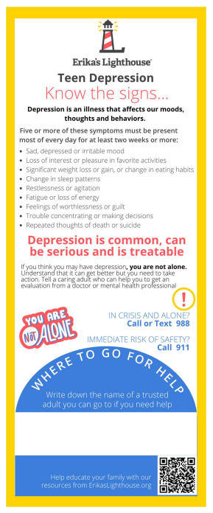
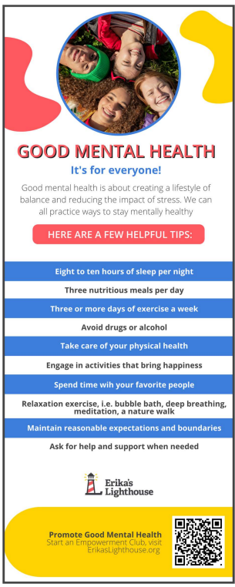

Student Bookmarks
Ideas of trusted adults:
Parent/Guardian
Aunt/Uncle/Grandparent
School Counselor
Coach
Teacher
Religious Leader
Therapist
Notes:
We want to ensure that students know where they can access a trusted adult at school. So, the student bookmarks have a blank space for you or the students to write down the name of the school counselor or school social worker. We encourage you to also include their office number so that students know where they can locate them in the building. If your school does not have an onsite counselor or social worker, you can encourage the students to write down who they identify as a trusted adult. That could be a family member, coach, someone in their community, or YOU!
You will notice, that on one side the student bookmark lists the signs and symptoms of depression and on the other side, there are tips for taking care of their mental health.

Slide 19

Good Mental Health & Coping
Good Mental Health Practices
Coping Strategies
Good sleep habits
Practicing self-care
Good eating habits
Being active
Mindfulness
Breathing techniques
Journaling

Slide 20

Whatever time: Day. Night. Weekend.
Whatever the reason: Mental health distress. Thoughts of suicide. Worried about a friend or loved one. Would like emotional support.
The 988 Suicide & Crisis Lifeline is here for you.
Text or Call 988 | Chat 988lifeline.org |
For emergencies, call 911

Slide 21
Everyone should have a Trusted Adult
Share examples of trusted adults at
Scoggins Middle School?

Slide 22
Post-Test
http://elhmspost.info

